Slide 1
STOCK PRICE PREDICTION Updated model
What is the Stock Market?
A stock market is a public market where you can buy and sell shares for publicly listed companies. The stocks, also known as equities, represent ownership in the company. the stock exchange is the mediator that allows the buying and selling of shares.

Slide 2
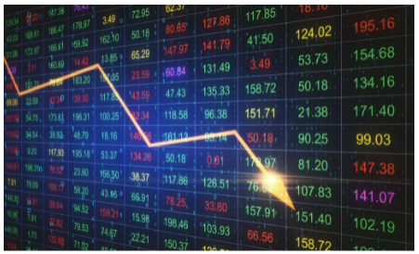

Slide 3
Stock Price Prediction
Stock Price Prediction using machine learning helps you discover the future value of company stock and other financial assets traded on an exchange. The entire idea of predicting stock prices is to gain significant profits. Predicting how the stock market will perform is a hard task to do. There are other factors involved in the prediction, such as physical and psychological factors, rational and irrational behavior, and so on. All these factors combine to make share prices dynamic and volatile. This makes it very difficult to predict stock prices with high accuracy.

Slide 4
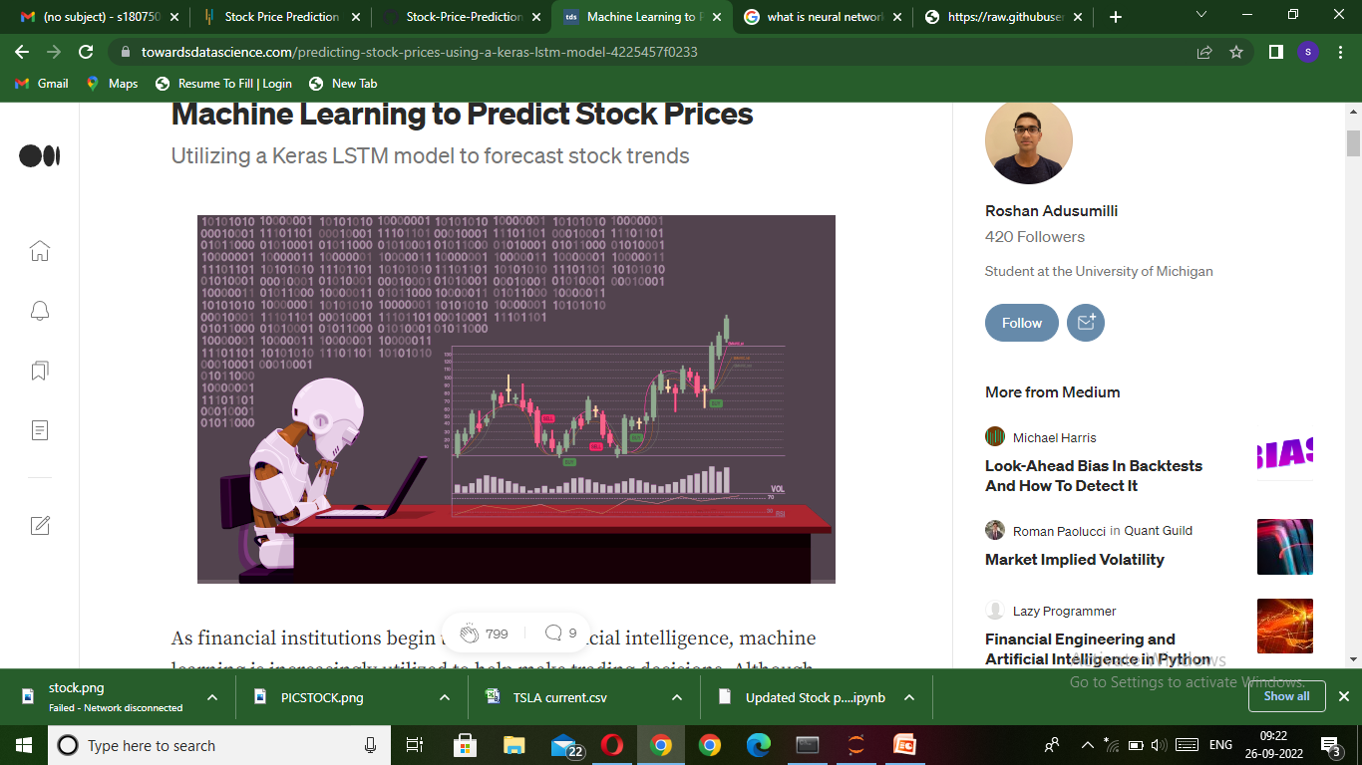

Slide 5
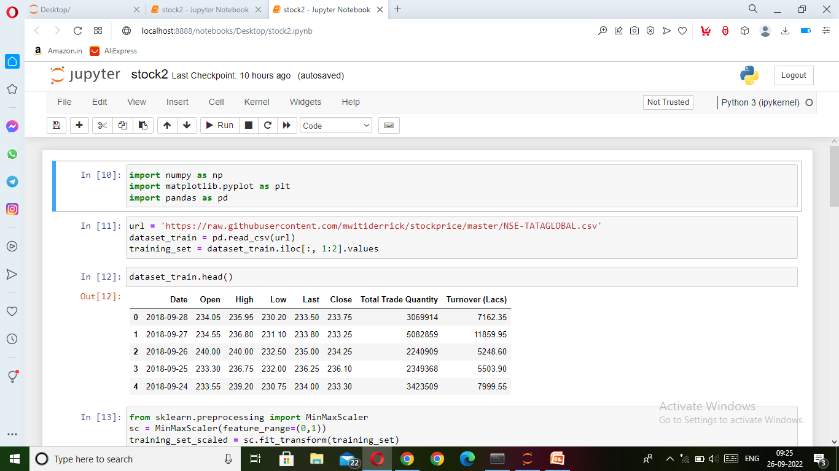
1. Import the Libraries.
To begin our project, we import numpy for making scientific computations, pandas for loading and modifying datasets, and matplotlib for plotting graphs.
import numpy as npimport matplotlib.pyplot as pltimport pandas as pd

Slide 6
Data Normalization
Normalization is changing the values of numeric columns in the dataset to a common scale, which helps the performance of our model. To scale the training dataset we use Scikit-Learn’s MinMaxScaler with numbers between zero and one.

Slide 7
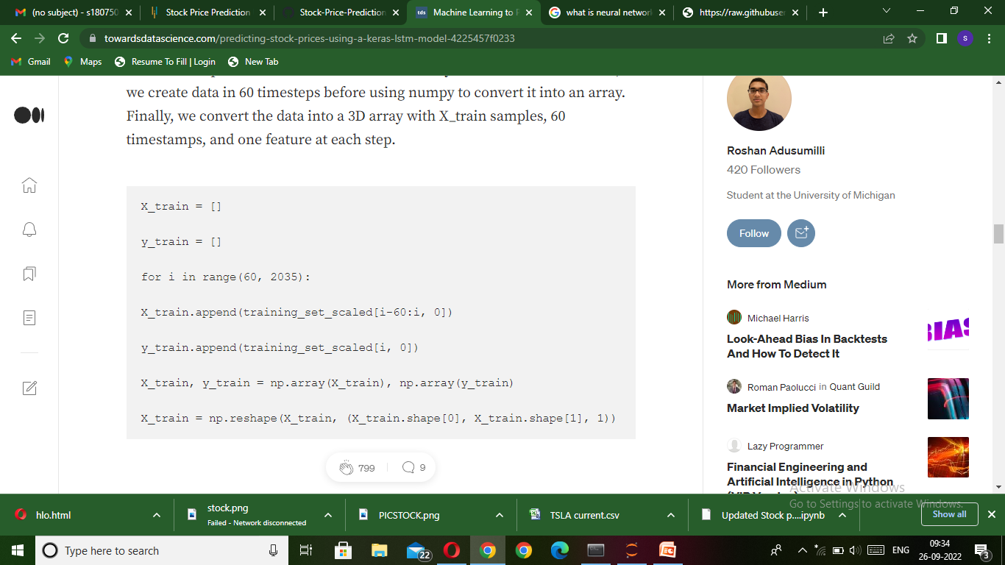
Incorporating Timesteps Into Data
We should input our data in the form of a 3D array to the LSTM model. First, we create data in 60 timesteps before using numpy to convert it into an array. Finally, we convert the data into a 3D array with X_train samples, 60 timestamps, and one feature at each step.

Slide 8
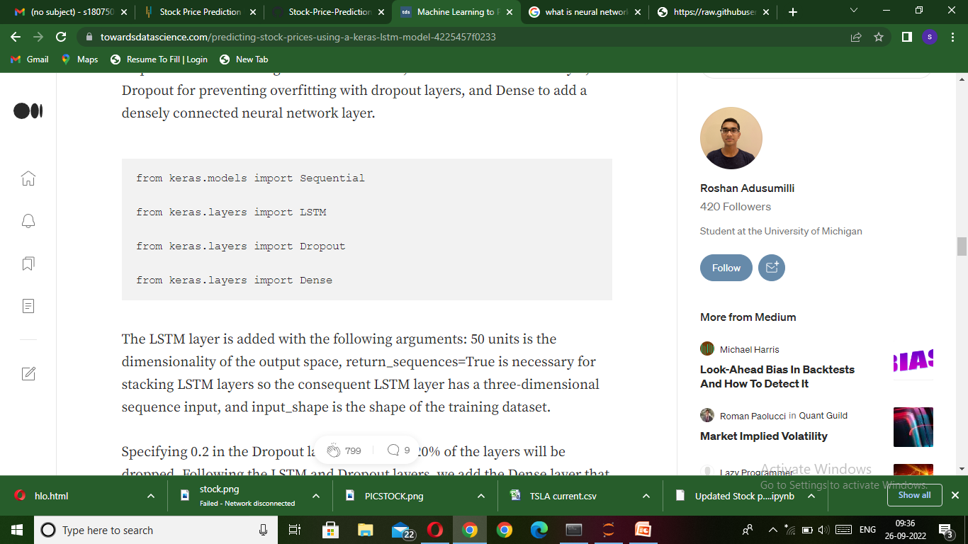
Creating the LSTM Model
Before we can develop the LSTM, we have to make a few imports from Keras: Sequential for initializing the neural network, LSTM to add the LSTM layer, Dropout for preventing overfitting with dropout layers, and Dense to add a densely connected neural network layer.

Slide 9
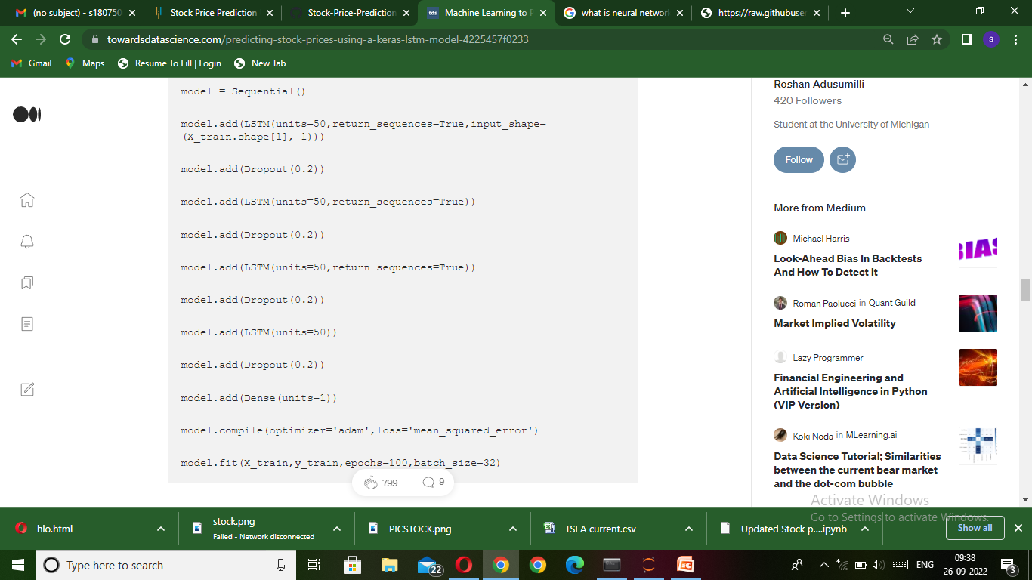

Slide 10
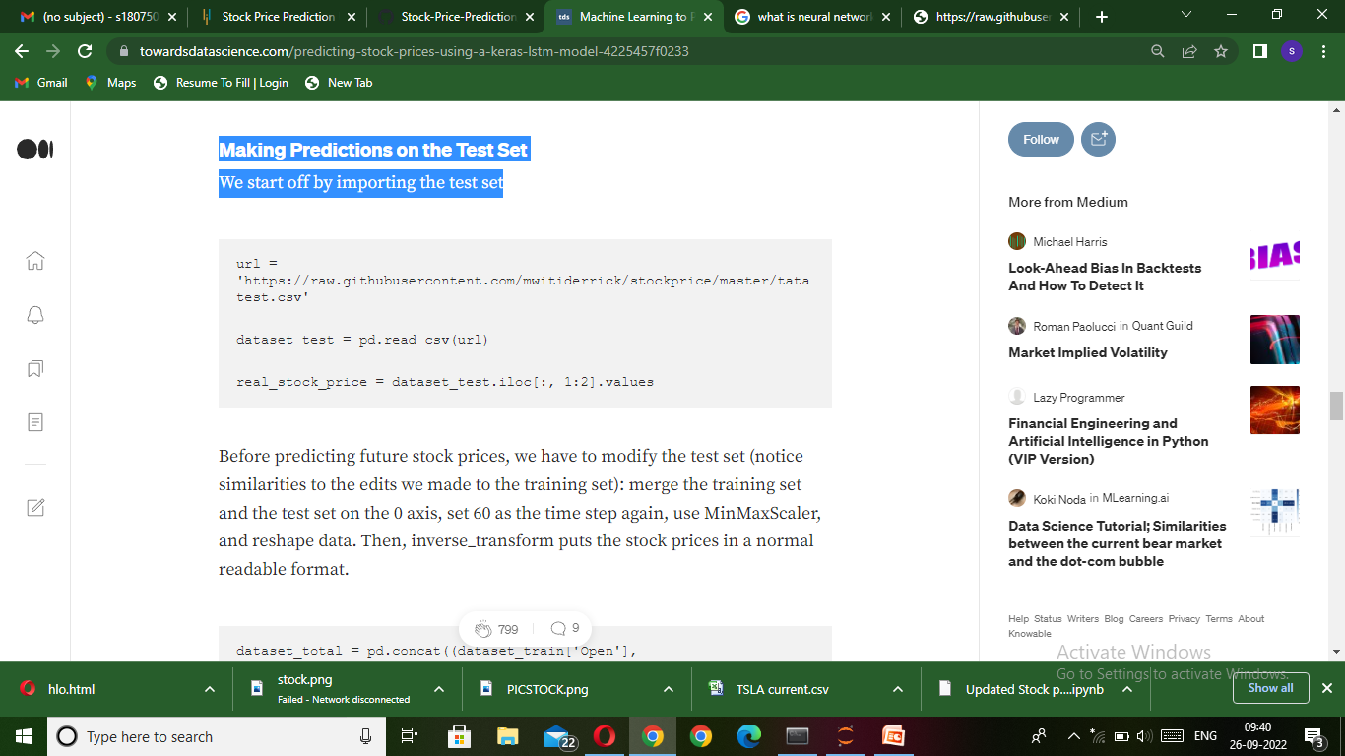
Making Predictions on the Test Set We start off by importing the test set u

Slide 11
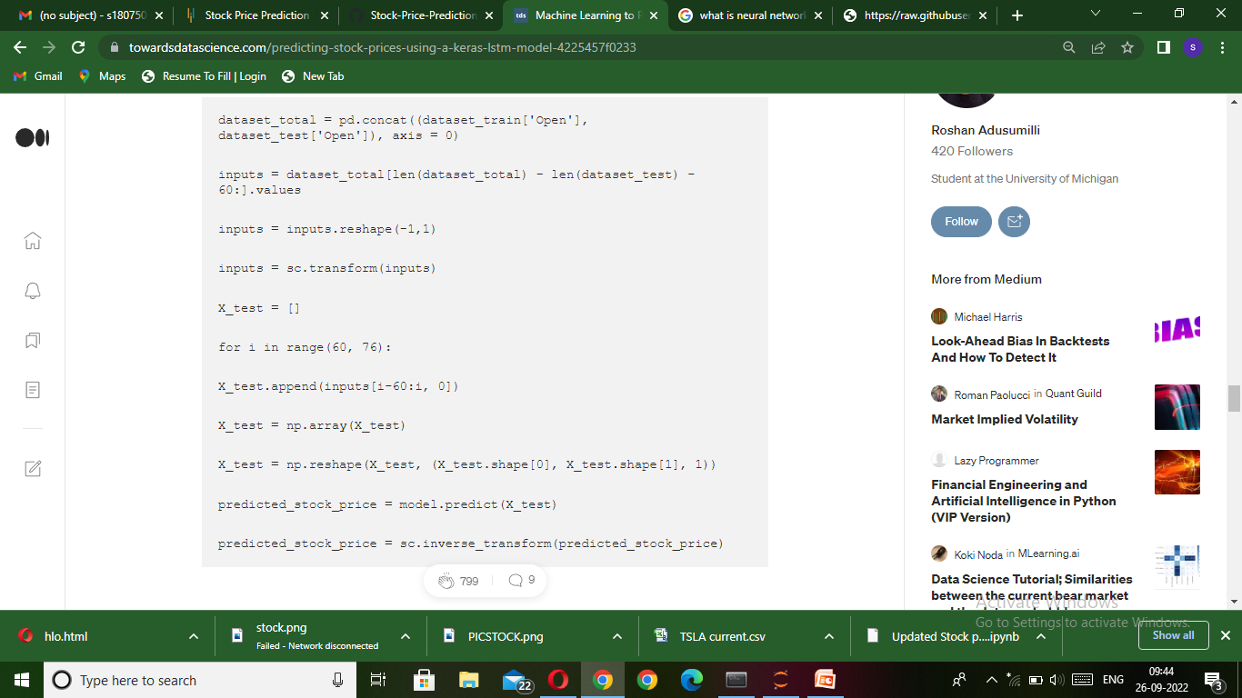

Slide 12
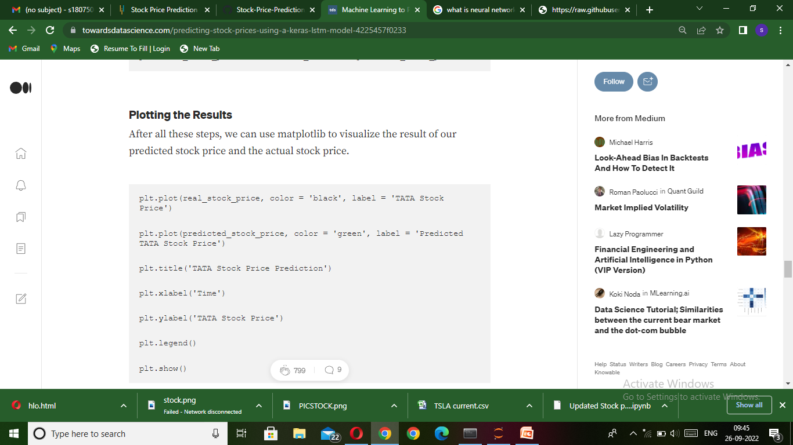
Plotting the Results After all these steps, we can use matplotlib to visualize the result of our predicted stock price and the actual stock price.

Slide 13
